Slide 1
Cliff Detection from RGB Images using
Depth Anything 3
Vincent Li, Ganesh Arivoli, Shruti Agarwal, Siddharth Barjatya
Notes:
a) Briefly explain what problem you are trying to solve [1 minute]
b) Why is this problem important? [1 minute]
c) What is your approach? Explain at an intuitive level, with just enough technical details needed to explain to a lay person. [2 minutes]
d) Show results and comparisons that demonstrate the benefit of using your approach. [2 minutes]
e) Discussion - what did you learn from doing this project? Where could this lead to in the future? [1 minute]

Slide 2

The Problem
A common problem amongst every day autonomous robots (such as picking robots used in warehouses) that use cameras for obstacle detections is the identification of cliffs.
Such devices use a combination of LiDAR and cameras to both navigate and detect and avoid obstacles – these sensors and detection algorithms do not easily detect depth.
This can cause robots to drive straight off “cliffs” such as stairs or edges of platforms
Standard 2D LiDAR scans map what is directly in front of a sensor at a fixed horizontal plane; a downward drop registers no return ping and is therefore invisible to the system.
Our goal is to use Depth-Anything-3, a monocular depth estimation model, to create a depth map of an image and then detect where a cliff may be

Slide 3
Why The Problem Matters
Simply knowing where the cliffs exist on the map is often not sufficient.
  Given the amount of noise these robots interact with in the real world, it is not uncommon for them to be de-localized.
  The ability to detect a cliff needs to be independent of the robot's position.
An inability to detect a cliff can lead a robot to drive off said cliff, leading to significant injury to people and property below the cliff, and the robot itself.
Cliff detection also needs to be solved with a very low false negative rate.
The algorithm needs to be efficient as well - needs to be able to detect a cliff and make a decision on impending danger with plenty of time
  These exact parameters are heavily dependent on the context of the situation and the robot itself, and were not considered a precise metric against which this project was measured.

Slide 4
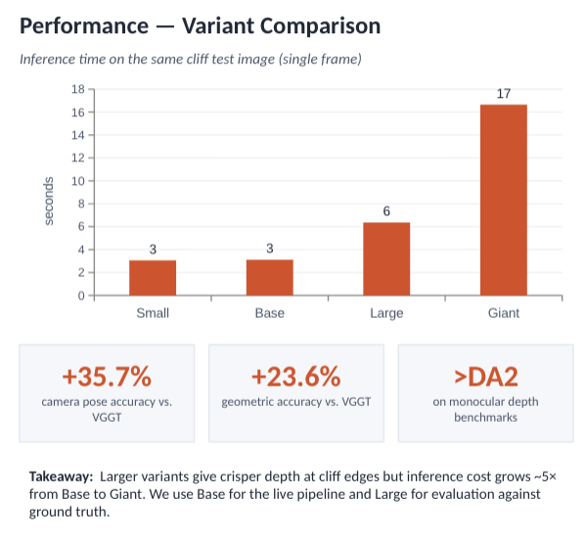
Depth-Anything 3
Monocular and multi-view depth model from ByteDance Seed.Predicts spatially
consistent 3D geometry from any number of RGB views, with or without known
camera poses. Outputs a per-pixel depth map, which our pipeline lifts into a 3D
point cloud for cliff detection.
Architecture
Single plain transformer backbone (vanilla DINOv2) no task-specific
heads or specialized modules.
Unified depth + ray prediction target removes the need for multi-task
learning.
Input-adaptive cross-view self-attention enables consistent geometry
across multiple frames.
Dual-DPT head decodes visual tokens into depth and ray maps.
Trained via teacher-student paradigm on public academic datasets
only.

Slide 5
Cliff Detection System Overview
Takes a video input and breaks it down into frames
  Number of frames is a tunable parameter - too few frames and the accuracy drops. Too many frames and the algorithm takes too long to run
Feeds each frame into Depth Anything 3 to estimate the depth of every pixel
  DA3 converts each the image into a depth map - each pixel gets assigned a value d, where a higher value indicates the point is “further” from the camera
Algorithm then “lifts” the 2D depth map into a 3D point cloud
Algorithm looks at the bottom half (closer to the camera) of the image/point cloud
From the bottom half, the algorithm identifies which depth value, and thus which points, are the floor level that the camera is on
Any spots that are below that floor level get flagged as the cliff
Marks the cliff and outputs the marked video - in a real application, this data could then be passed into a navigation or autonomous movement decision-making algorithm
Video Input
Depth Anything 3
3D Point Cloud
Floor Detection
Cliff Flagging
Marked Output

Slide 6
Key Implementation Points
We check the bottom 50% of the frame to identify exactly what the surface or ground plane height is.
  This is important because we could otherwise misidentify random foreground or background obstacles as the “ground-level”, causing completely incorrect cliff estimates.
We use a technique called RANSAC to identify the best-fit ground plane
We test the algorithm with two types of data: real-world and sim generated
Tunable parameters include:
  Camera intrinsics (fx, fy)
  The RANSAC residual threshold
  The cliff height threshold
  The assumed ground region (the 50% number)

Slide 7
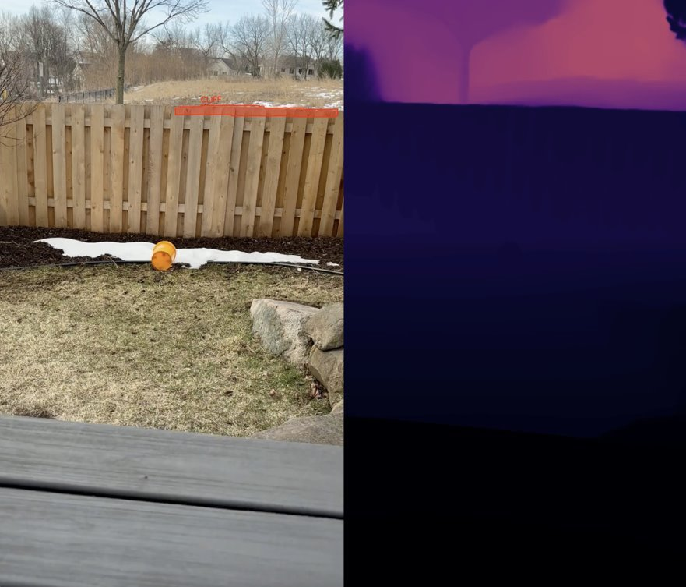
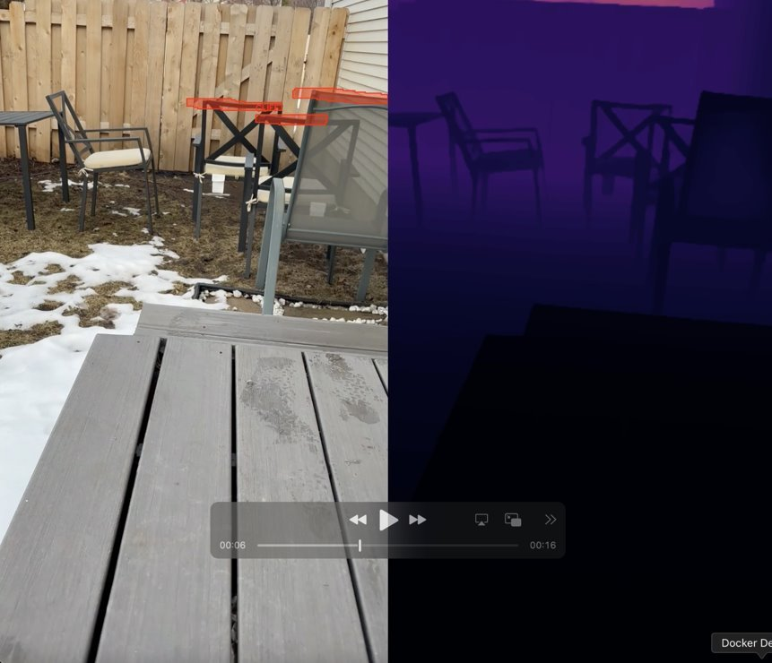
Example of Misidentified Cliffs

Slide 8
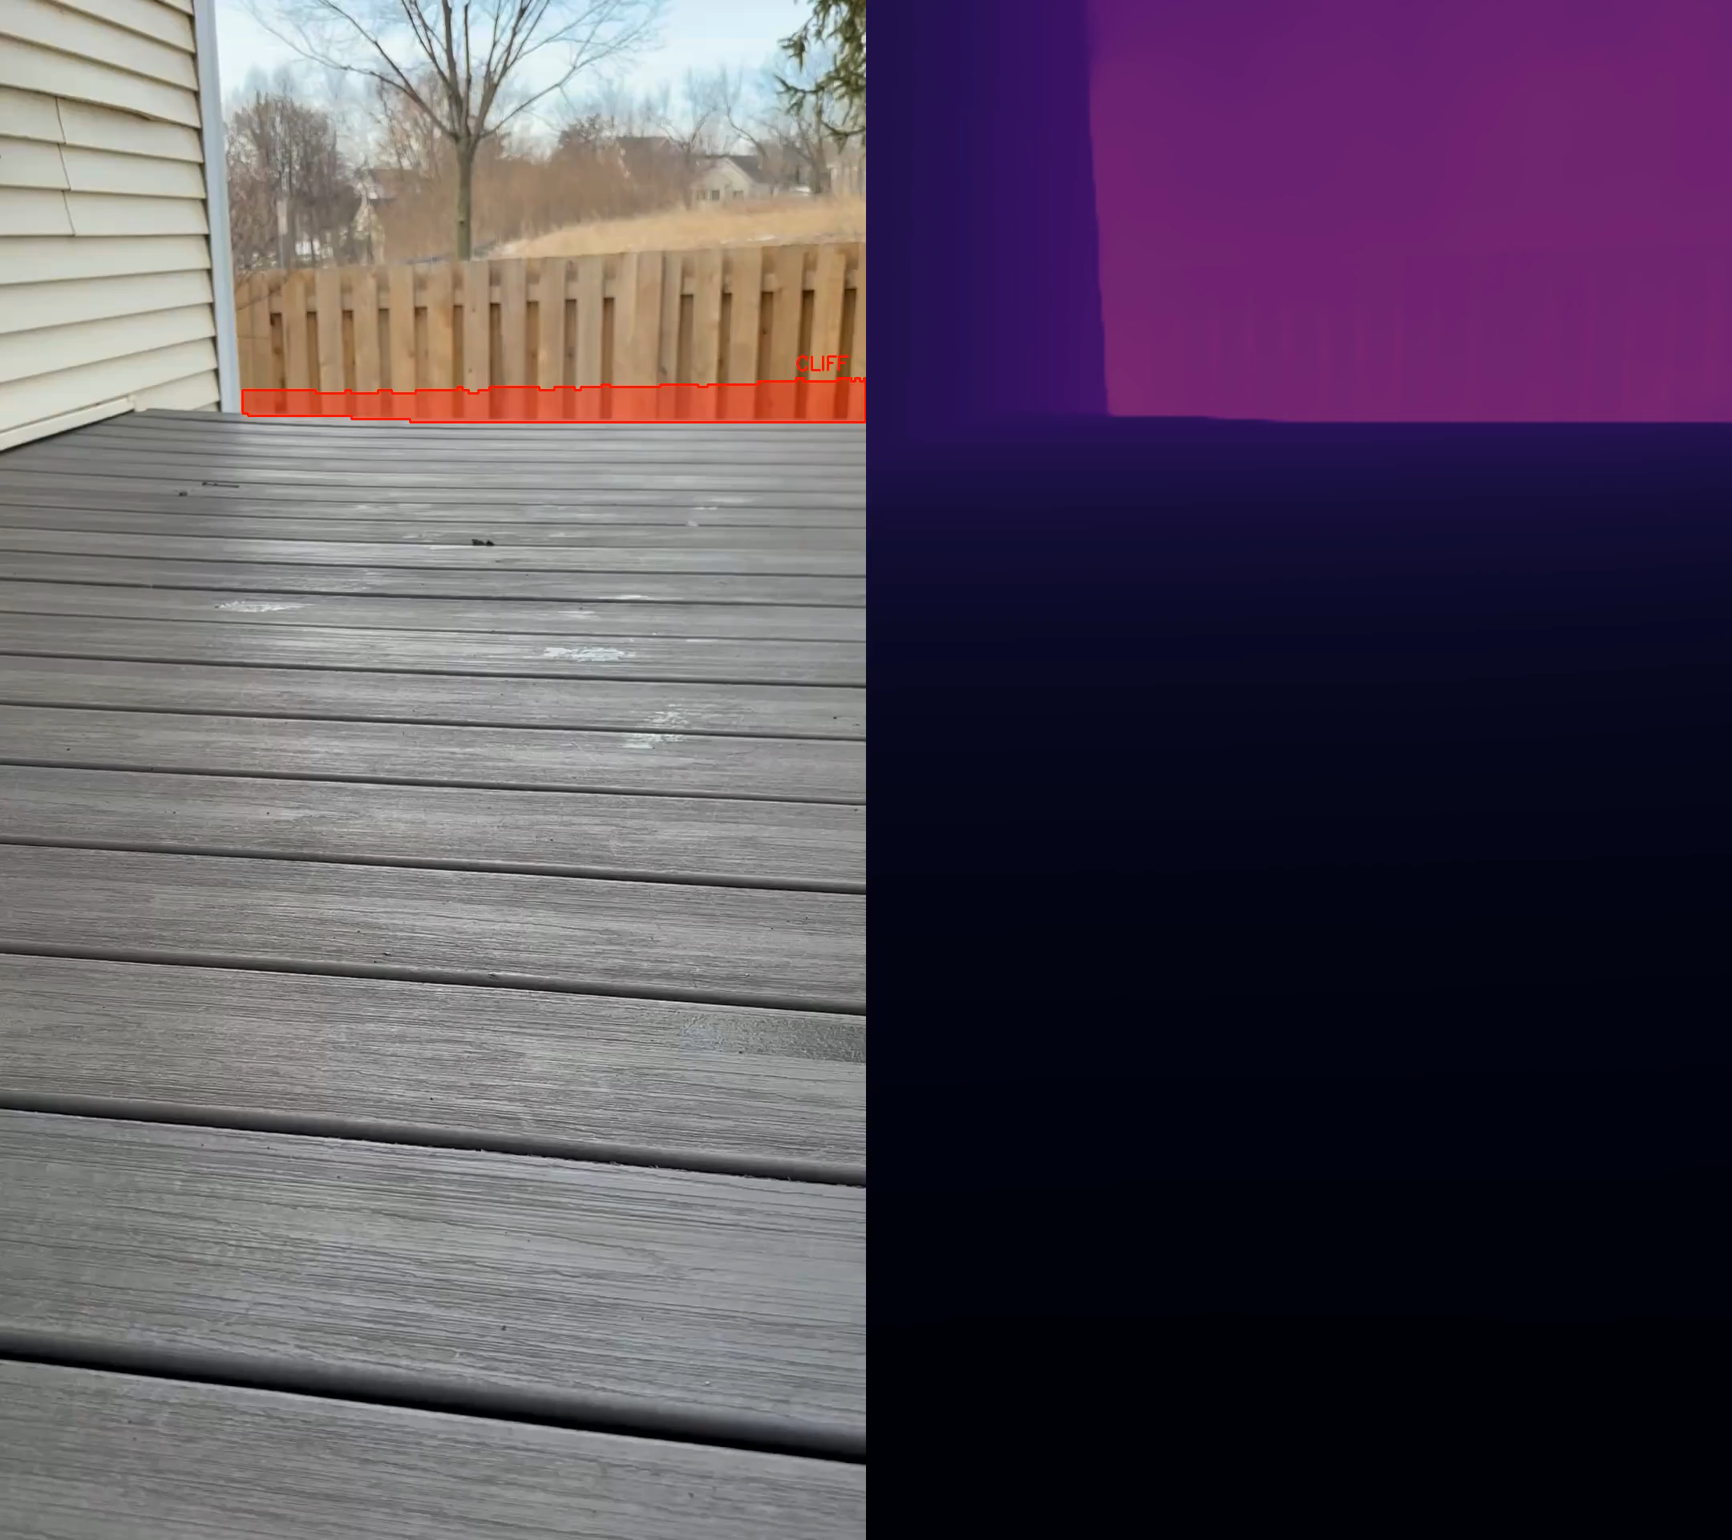
Cliff Detection Demonstration

Slide 9
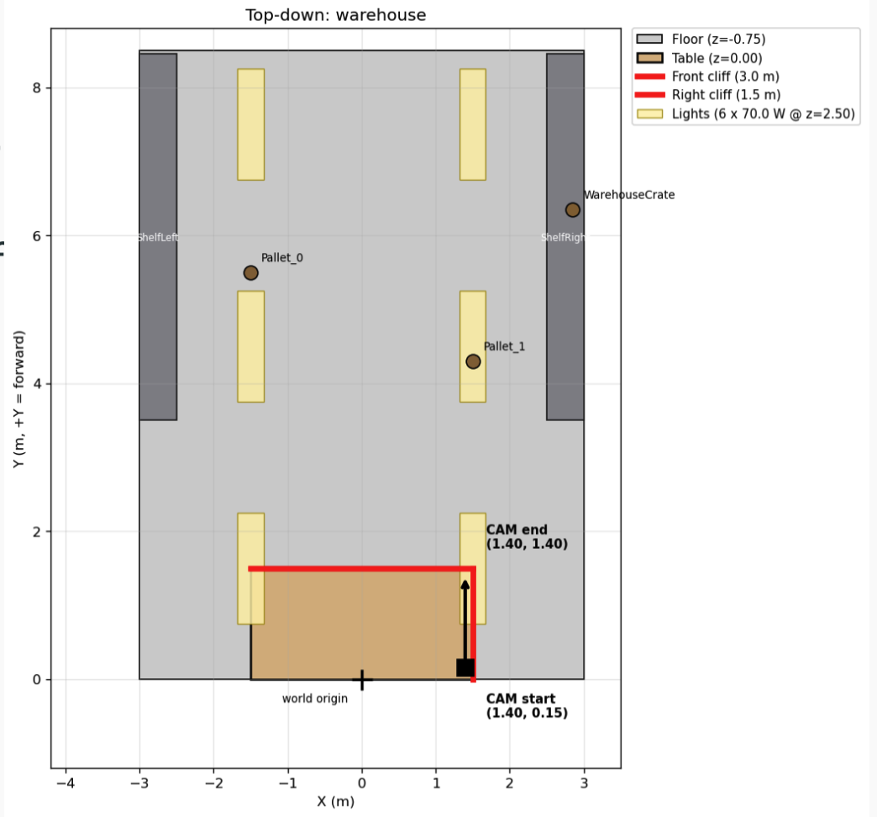
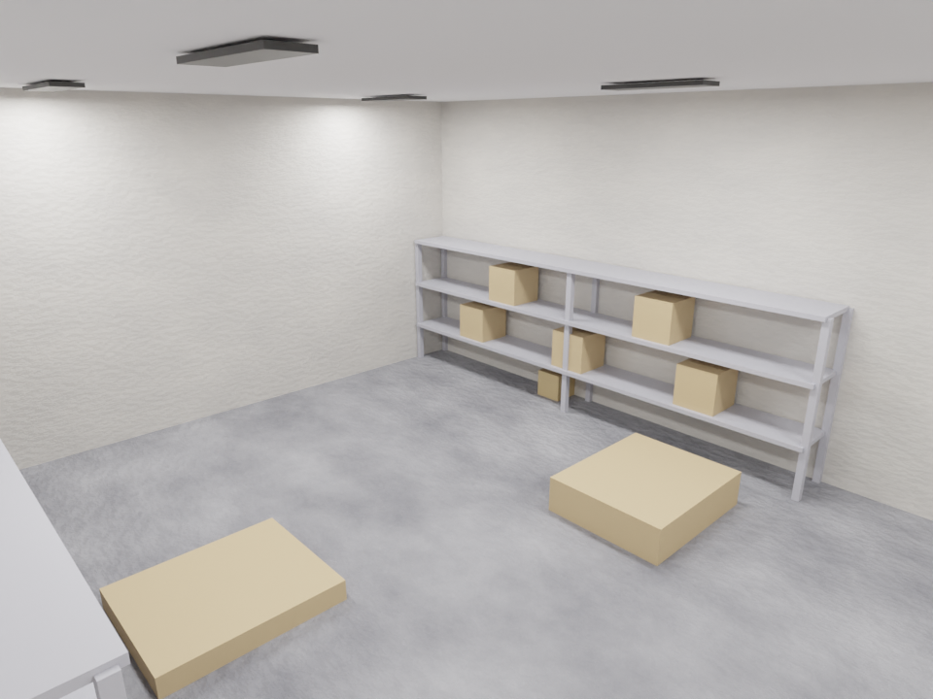
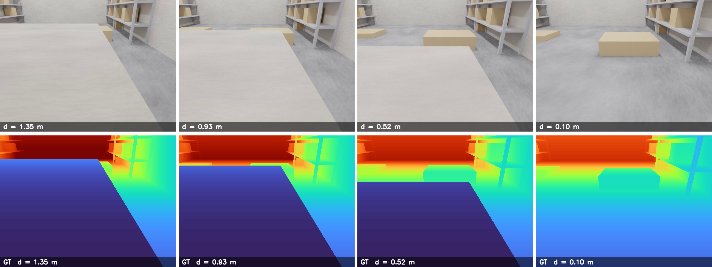
Simulation for Data Generation + Evaluation
Why simulation data instead of only real-world data
Per-pixel ground-truth depth. Real RGB-D sensors fail at depth discontinuities and far ranges — the cases we care about — so they can't serve as ground truth for cliff metrics.
Safety + cost. Driving a real robot toward stairs or a loading bay is expensive and unsafe; a simulator runs the same trajectory thousands of times.
Controlled variation. Geometry, textures, lighting, camera path, and cliff distance are all parameters we set — isolating which factor breaks DA3 is impossible with a fixed real dataset.
Reproducibility. A scene script + seed regenerates the exact same frames for identical evals
Top-down view of the scene
Image showing the generated scene
Image showing the generated camera image and ground truth depth data

Slide 10
Pipeline
Scene - Blender generated scene with assets
Render - VisionSIM for RGB + ground truth depth
Optional: Camera transforms for DA3
Inference - DA3 outputs depth
Alignment - scale + shift fit to GT
Metrics – Slide 11
Extra Additions:
Added sliding-window for video inference
Weighted alignment for trajectories
Scene — Blender
Render — VisionSIM
Inference — DA3
Alignment — scale + shift
Metrics — AbsRel, RMSE
Sliding-window inference
Weighted alignment (trajectories)
video frames (window slides forward)
dot size = weight · dashed = GT
VisionSIM: https://github.com/WISION-Lab/visionsim

Slide 11
Evaluation - Warehouse Scene
Warehouse interior built around a loading-dock cliff:
A 3 m × 1.5 m dock that drops 0.75 m onto a floor.
Lighting is a 2×3 grid of 70 W high-bay fluorescent fixtures.
Resolution 640 × 480, 70° HFOV
Pitch −25° (looking down at dock edge)
Trajectory head-on approach, 1.25 m travel
Speed 0.2 m/s
FPS / frames 25 fps, 137 frames
Cliff front edge at y = 1.5 m, 0.75 m drop
Model DA3-Large
Metric | LS median | LS mean | RANSAC median | RANSAC mean
AbsRel | 0.090 | 0.119 | 0.099 | 0.254
RMSE (m) | 0.476 | 0.509 | 0.279 | 0.389
δ < 1.25 | 94.96 | 83.82 | 91.45 | 84.79
δ < 1.25² | 99.67 | 94.80 | 99.64 | 90.37
δ < 1.25³ | 99.78 | 97.26 | 99.75 | 92.40
137 frames, head-on approach, GT distance 1.35 m → 0.10 m. Bold = better.
Best/worst frame (LS): #156 AbsRel 0.009 / #120 AbsRel 0.467.
Per-frame scale 0.49–2.44, shift −0.56–+0.02 — DA3 scale drifts along trajectory.
Mean ≪ median: a few bad frames dominate the average.
AbsRel mean |pred−gt|/gt — typical relative error.
RMSE √mean(err²) in m — penalizes worst pixels.
δ < 1.25ᵏ % pixels with max(p/g, g/p) < 1.25ᵏ.
Median vs mean gap exposes outlier frames.
Image showing the generated scene

Slide 12
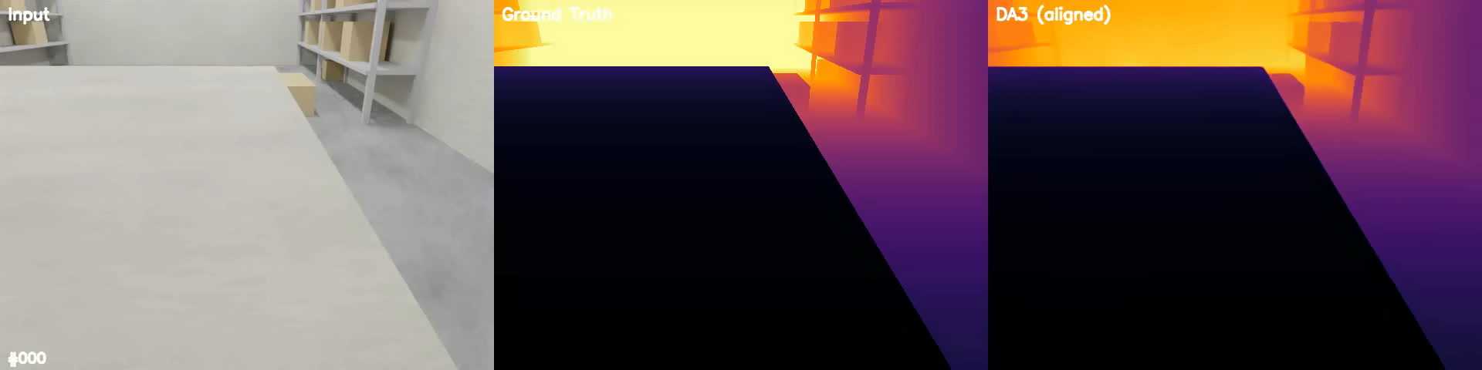
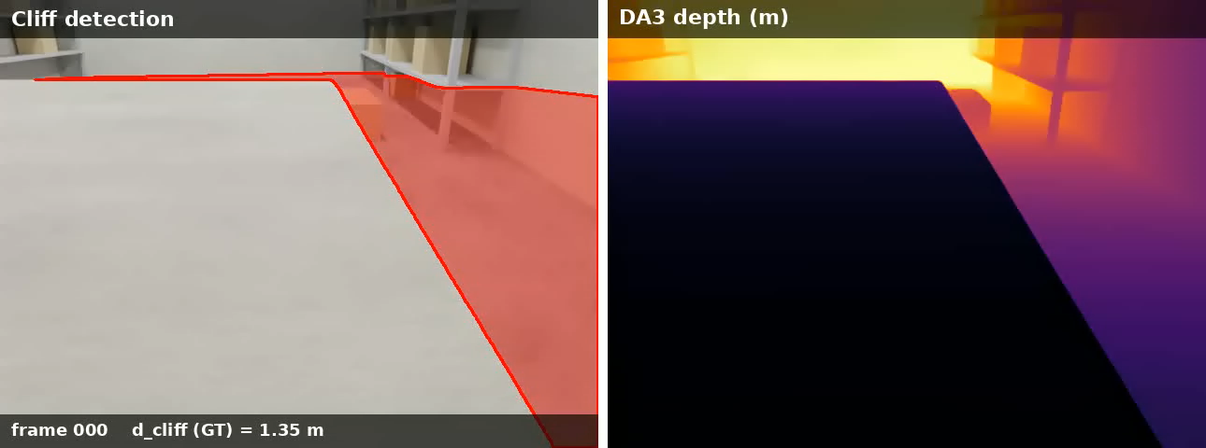
Video demonstrating the pipeline

Slide 13
Discussion
Current depth detection models (such as DA3) may not be efficient enough for this to be practical in a real-world application. Running on a standard Apple 2021 M1 chip:
  Sampling at 2 fps using the smallest DA3 model (BASE), depth inference on a 1 min video takes ~10 minutes. Using the LARGE model takes ~40 minutes.
  Actual cliff detection algorithm on the raw inference map is relatively quick, ~ 7 seconds for the 1 min video at 2 fps.
  Further study needs to be done on optimizing algorithms and hardware required to run the algorithm in an acceptable time frame
One major flaw with the cliff detection algorithm is that when we are close to the edge, the plane below the cliff takes up more of the bottom 50% frame than the ground plane, causing RANSAC to identify that as the ground plane and thus not identifying the cliff
  In real-world application, this is likely not as big of a problem. The cliff would be detected much earlier, and other autonomous movement techniques (odometry, localization) could be leveraged to help remember the location of the cliff and avoid it.
Align the dynamics in the simulation data with a physics-based sim engine like Project Chrono and add control policy into the loop during evaluation

